Slide 1
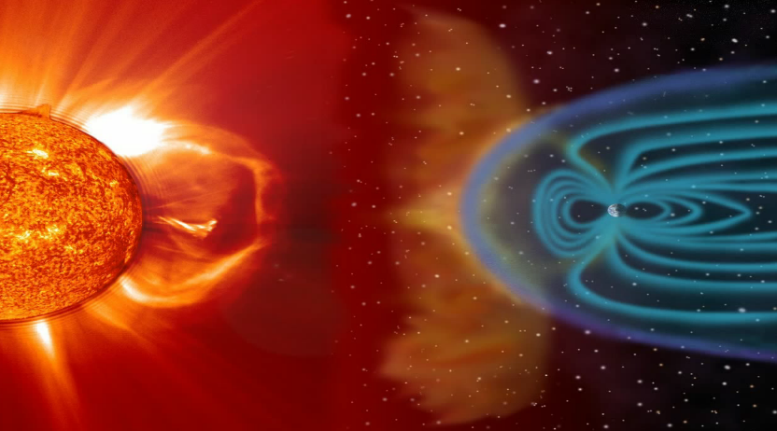
An invisible magnetic field that surrounds the Earth is generated because the inner and the outer core spins at different speeds .
Microwaves
Solar Wind
Earth’s magnetic field
Cosmic Radiation
(Very dangerous)
Protects us from being destroyed
Radioactive Particles
The magnetic force field deflects the deadly cosmic rays away from the Earth .

