Slide 1
Soil Horizons
Graphic Organizer

Slide 2
Define soil structure/profile and soil horizon.
Textbook page 289-290
Soil
Soil Horizon
Mixture of organic materials, weathered rock, minerals, water, and air that can support plant growth.
The arrangement and names of the soil parts

Slide 3
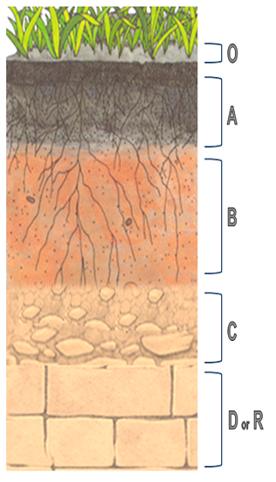
Soil Horizon | Name and Description | Illustration (Picture)
O
A
B
C
R
Organic Layer Litter, dead materials, leaves, bugs, twigs,
Top Soil (HUMUS) Most Fertile soil
Decayed organic material (rotting)
Sub Soil Sand, Clay, Silt, Nutrients and Minerals
Partially weathered rocks
Weathered Rocks: broken rocks
Bedrock Solid rock, No weathering

